Slide 1
IP Search Tools

Slide 2
Espacenet
Notes:
This presentation is all about searching patents with Espacenet, the EPO's worldwide patents database.

Slide 3
Resources
http://worldwide.espacenet.com Espacenet
espacenet@epo.org Espacenet helpdesk

Slide 4
Espacenet: the original idea
European/worldwide patent information on the internet
Showcase for all participating national patent offices
Own-language interface
For intelligent non-experts
User-friendly
Raises awareness
Does not replace professional services
Notes:
The original ideas behind Espacenet were
to provide an internet platform for the EPO to display its own patent documents and those in the worldwide database and for the national offices to display their patent documents
to create initial access to patents for users in the member states, in their own language
to create access to patents for users who are not patent experts
to provide user-friendly access and
to raise awareness of patents as a source of technical information.
Espacenet was not, however, intended to replace professional services such as those provided by patent agents.

Slide 5
Who are the potential users?
Scientists
Engineers
Lawyers
Economists/business administrators
Historians
Notes:
Various kinds of information can be extracted from published patent documents. This information can be technical, scientific, legal or commercial in nature, so it is of interest to a wide range of potential users, including scientists, engineers, lawyers, economists and historians.

Slide 6
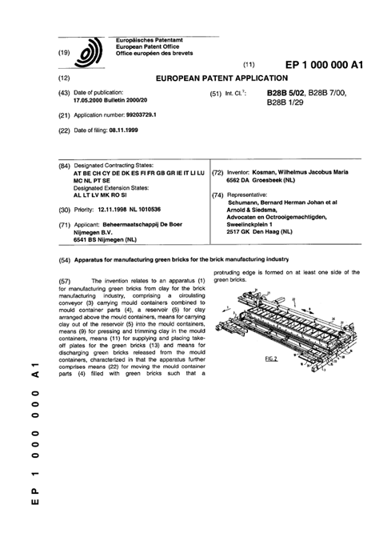
The structure of patent documents
Front page
Bibliographic data
Title
Abstract
Description
Drawings
Claims
Search report
Notes:
All published patent documents have a specific structure irrespective of the patent office which issued them.
With Espacenet it is possible to search specifically in the front page bibliographic data and the front page title and abstract.
Where the Espacenet database contains full-text searchable documents, it is also possible to search the description and claims.
It is not possible to search diagrams or search reports. These sections are displayed when a patent record is retrieved.
The different sections will be defined and explained in the following slides.

Slide 7
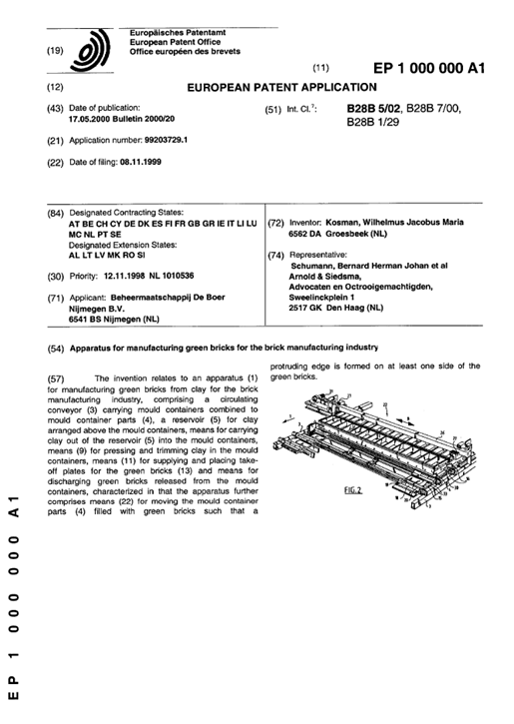
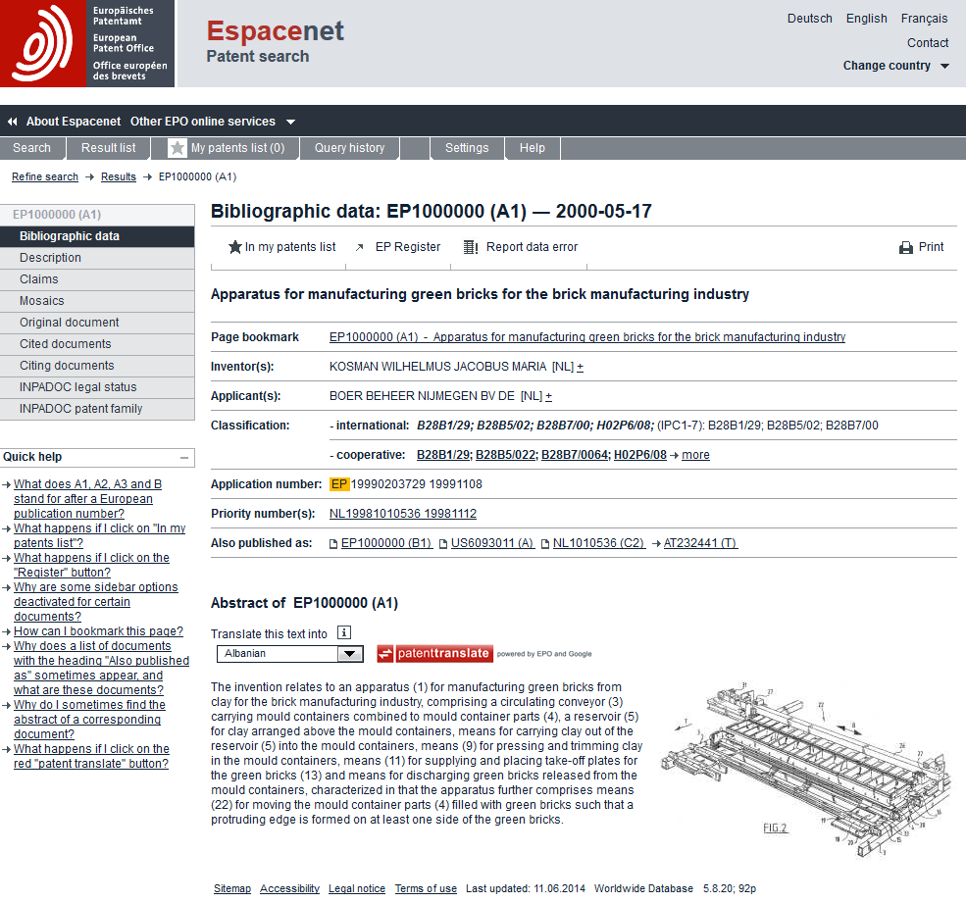
The front page
Notes:
On the front page, the searchable fields are the title, the abstract, the inventor and the applicant. The publication number – which is a sequential number assigned to the publication by the patent office – is also searchable, as is the application number – a sequential number given by the patent office as a patent application is filed – and the priority number, which is the application number given by the office of first filing.
Publication data and patent classifications can also be searched.

Slide 8
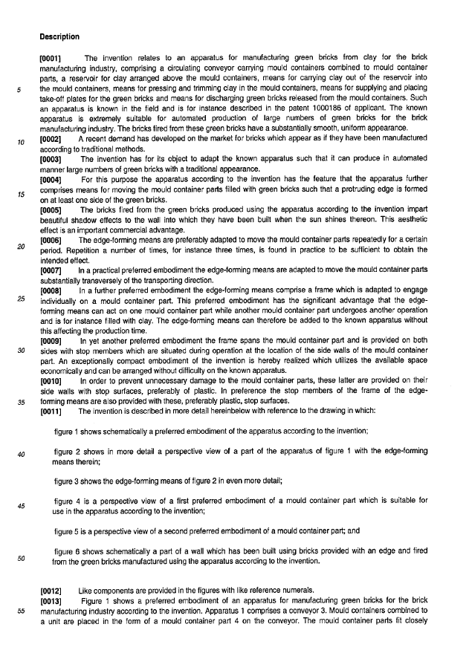
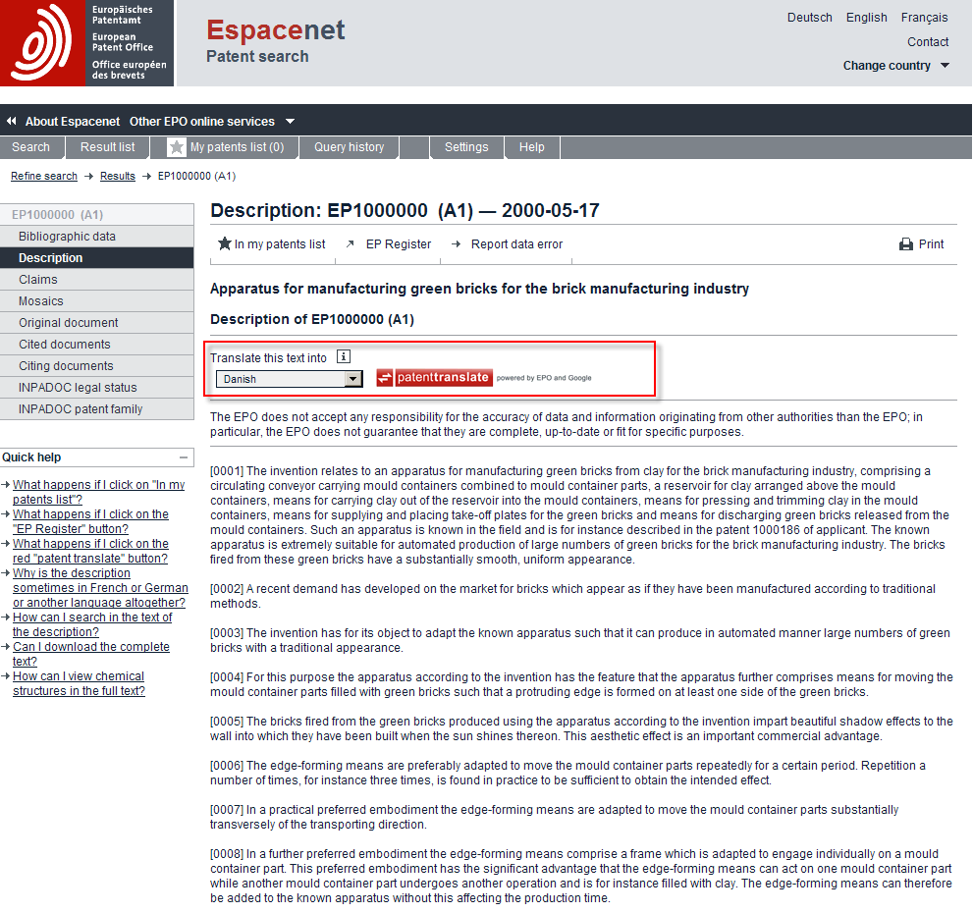
The description
Notes:
The description is the most important section from the technological point of view. It has to be clear and sufficiently complete for an outsider to be able to reproduce the invention. This is rather similar to the requirements for scientific publications in the conventional literature.

Slide 9
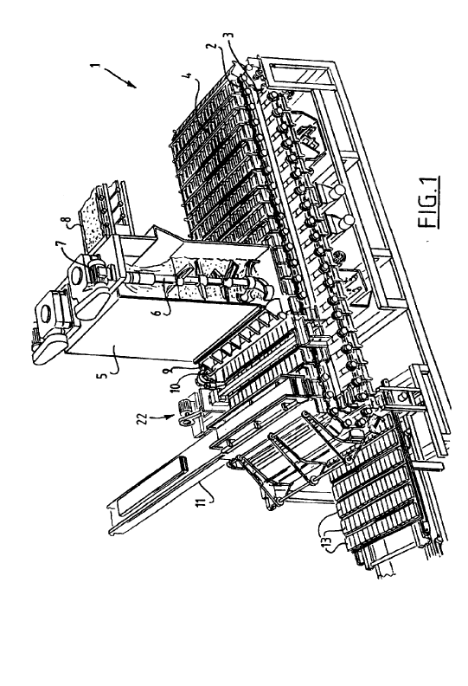
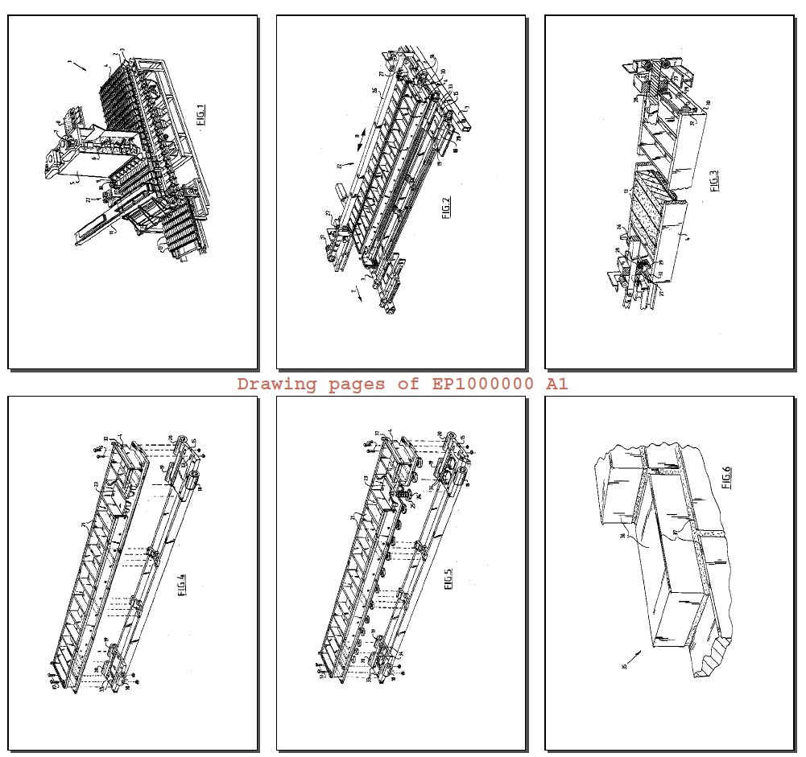
The drawings
Notes:
Very often, as in conventional scientific literature, patents contain diagrams or other graphics concerned with the invention. The graphics can be diagrams (engineering drawings), molecular structures, circuit diagrams, photographs, diffraction patterns, spectra, graphs, charts, gene sequences and so on.
Espacenet displays patent diagrams in two ways. One is the mosaic view, which groups all the diagrams on a single page. The original document view allows all of the pages of a document including the diagrams to be displayed in PDF format.

Slide 10
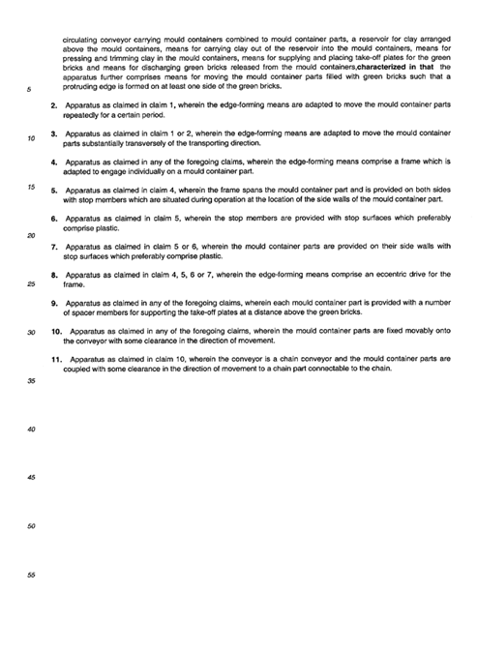
The claims
Notes:
The claims define the legal scope of the patent. They define the area of technology for which patent protection is requested.
In any given patent application, the allowable sets of claims are for a product, a process involving the product, or an application of the product.
The first claim in any of the above sets is called an independent claim. All other claims which refer to the independent claim are called dependent claims.

Slide 11
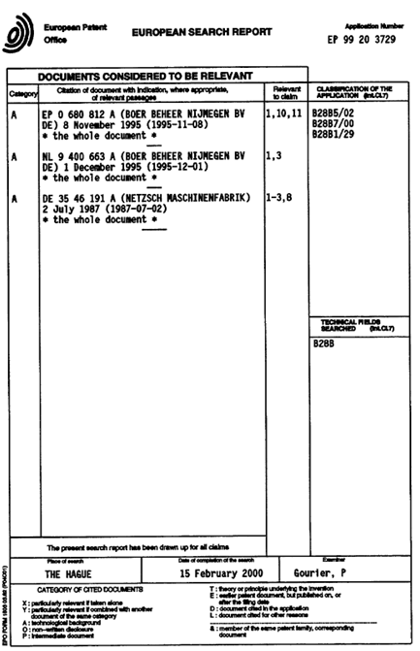
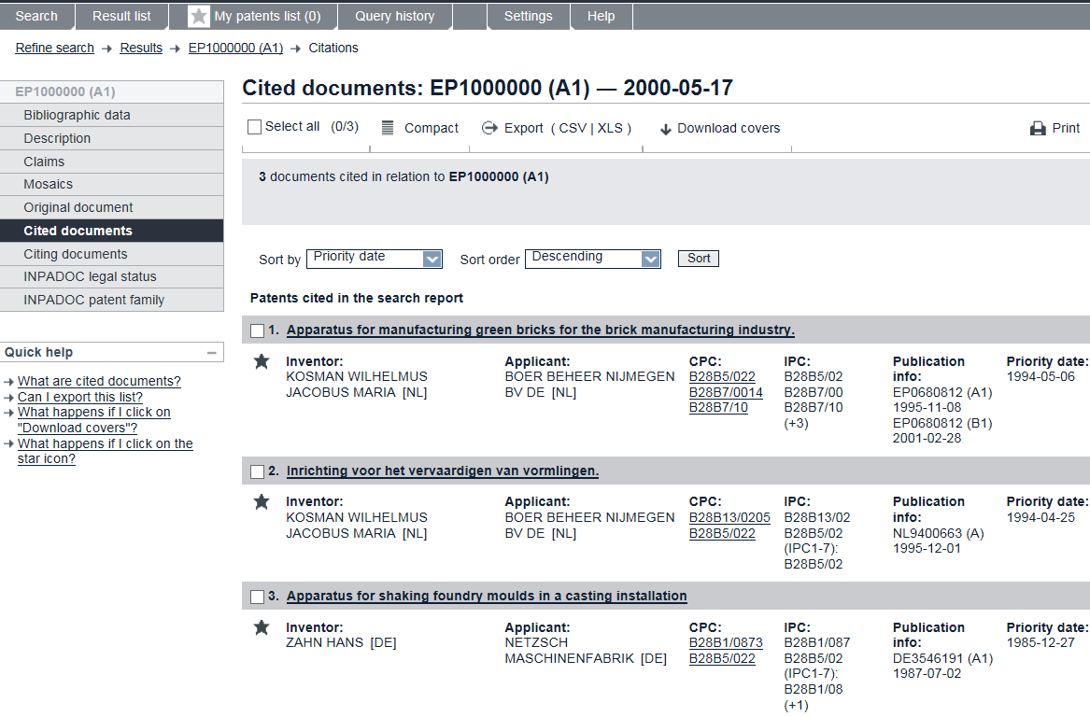
The search report
"Cited documents" view.........
...corresponds to documents cited in the search report, found in the "Original document" view
Notes:
The search report is a document produced by the patent examiner after he or she has carried out a patentability search. In it the examiner compares the current patent application with previously published material known in the patent world as “prior art”.

Slide 12
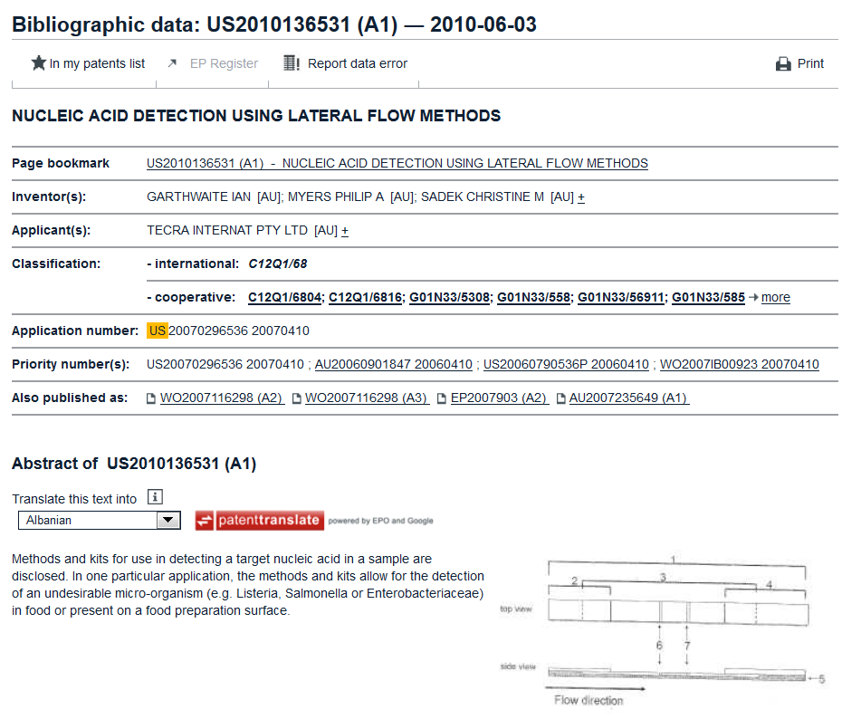
Technology-specific: biochemistry
Notes:
The next few slides show patent applications from different technological areas.
This is a patent from the biotech area.

Slide 13
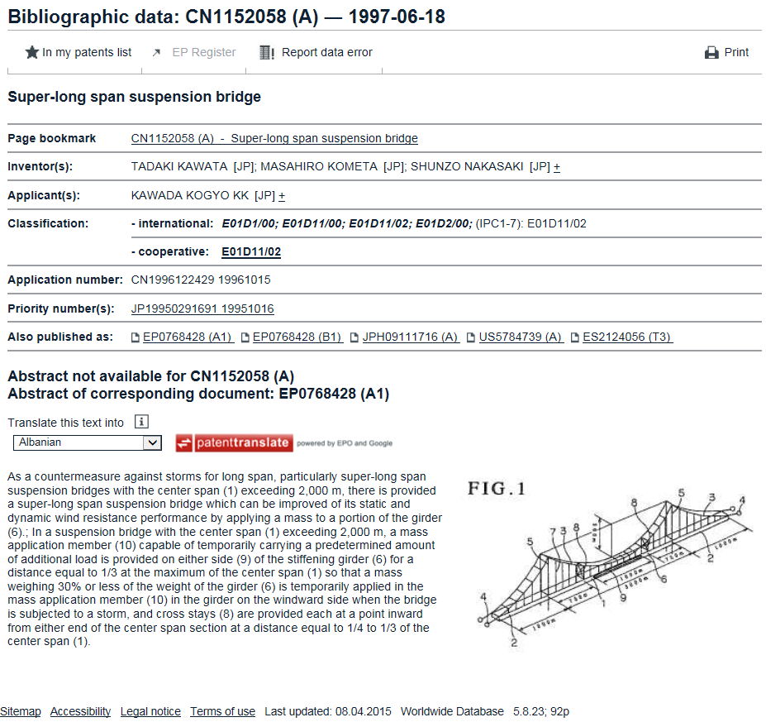
Technology-specific: civil engineering
Notes:
This is a patent application from the civil engineering field. It concerns the damping of deck vibrations in super-long suspension bridges.

Slide 14
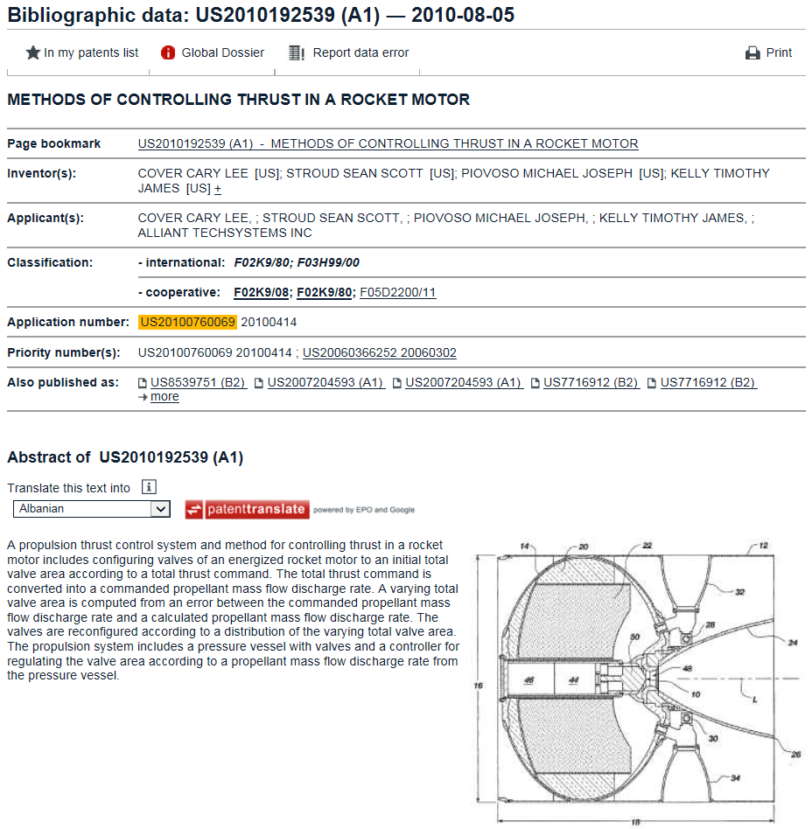
Technology-specific: aerospace
Notes:
This is a patent application in the aerospace sector. It relates to vectoring the thrust of rocket motors.

Slide 15
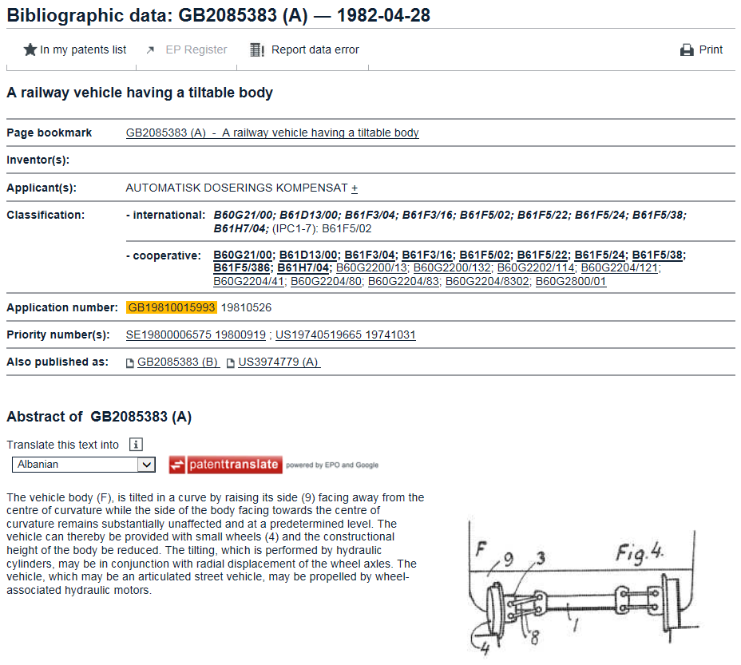
Technology-specific: transport
Notes:
This is a patent in the field of transport technology. It is for a tilting train where the wheels remain in contact with a flat or cambered track, but the train body tilts towards the centre of the bend, enabling the train to travel faster around the curve.

Slide 16
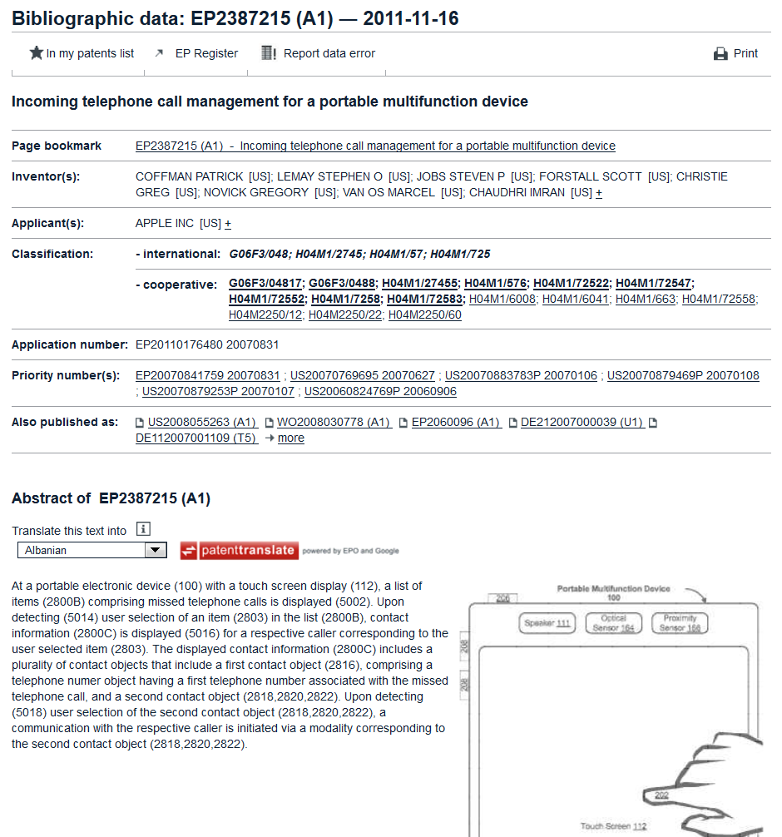
Technology-specific: ICT
Notes:
This patent in the ICT field is for a touchscreen mobile device which allows for the management of incoming telephone calls.

Slide 17
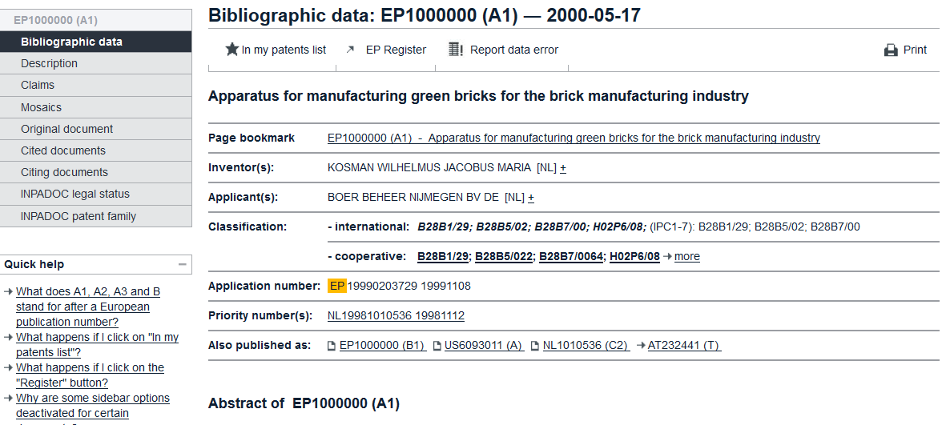
Legal status
Notes:
Patent documents are not only about the substance of the invention, the technology embedded in a patent application. They are also concerned with legal issues such as ownership, legal status and validity, and whether or not a patent has been granted or is still pending.
A patent is a legal title.
It is possible to link from a European patent publication in Espacenet to the corresponding record in the European Patent Register.

Slide 18
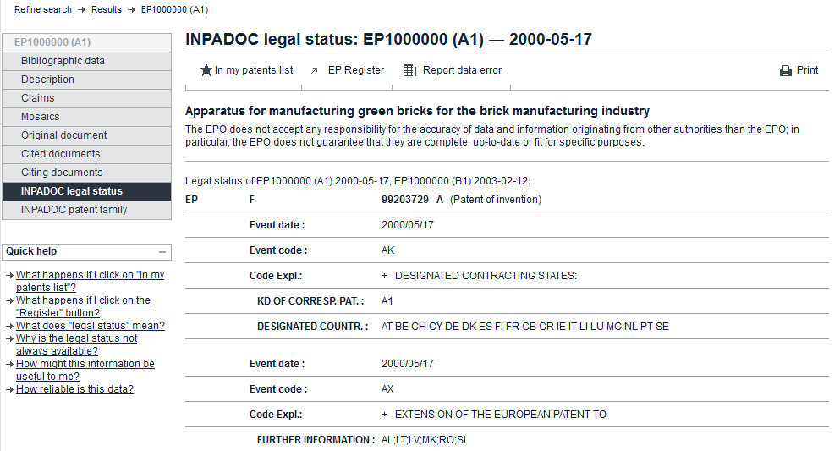
Legal status: validity
Notes:
Within Espacenet it is possible to investigate the legal status of a patent application or granted patent. In this case we're looking at the legal status of EP1000000, and we can see the part of the record which shows the designated states and the extension states, during the early life of this patent application.

Slide 19
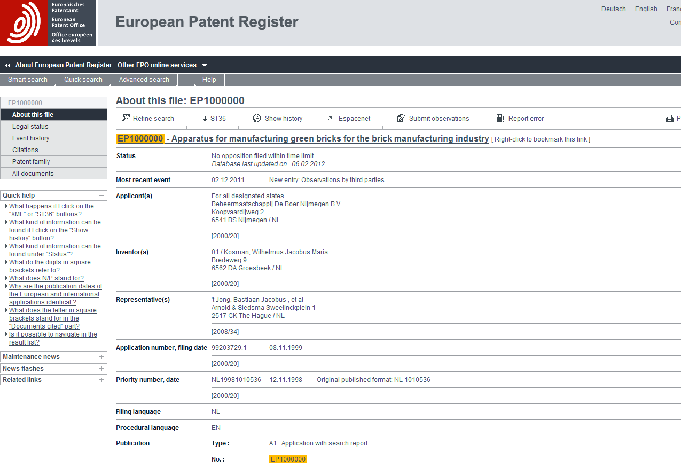
Legal status: procedural
Notes:
Going back to the European Patent Register from Espacenet we can look up the procedural status of this patent application.
In the "About this file" view we can see the relevant bibliographic information. The European Patent Register only shows information about a European patent application once it has been published.
After that we can look up the procedural status to see what stage the application has reached. A simple procedure would consist of search, examination and grant.

Slide 20
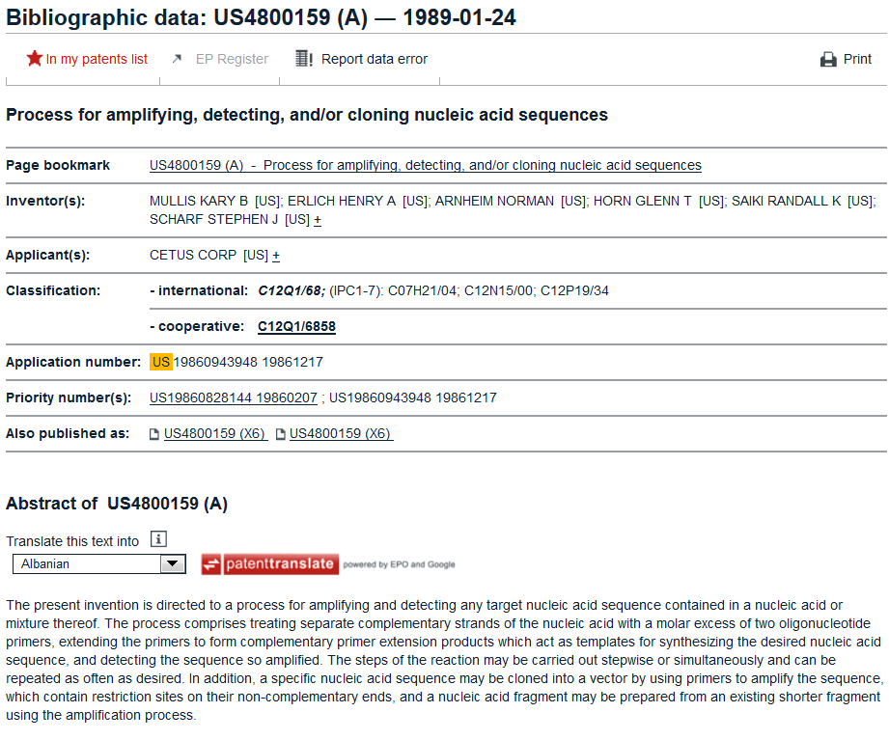
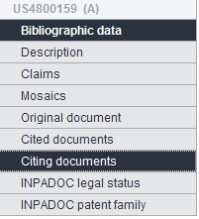
Commercial relevance: technological impact (I)
Notes:
Kary Mullis is a scientist who received the Nobel prize for Chemistry for contributions to the developments of methods within DNA-based chemistry. Mullis shared the award with Michael Smith. Mullis' half of the award was for his invention of the polymerase chain reaction (PCR) method.
This slide shows one of Mullis' early patent applications, published in 1989 for a "Process for amplifying, detecting and/or cloning nucleic acid sequences" and having the number US4800159. This turned out to be a significant invention, forming as it did the basis for commercial PCR technology.
You can get a good idea of how important a particular invention is by finding out how many later patent applications cite it.

Slide 21
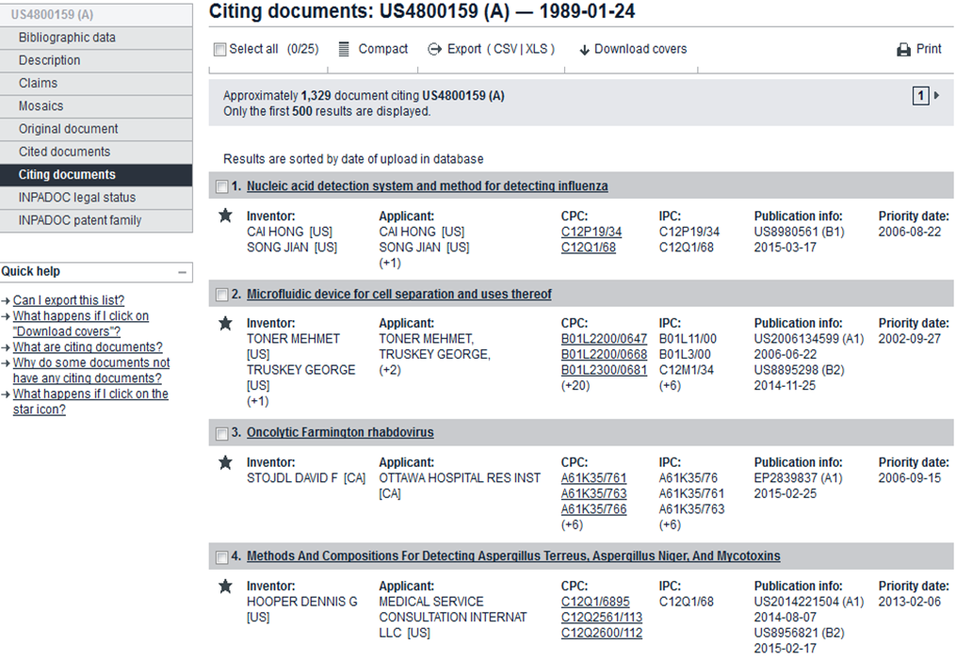
Commercial relevance: technological impact (II)
248 (2010)
839 (May 2012)
980 (Nov 2012)
1 269 (Oct 2014)
1 329 (May 2015)
Notes:
US4800159 turned out to be a blockbuster for Mullis. This is the "citing documents" list for that patent. It shows the citations made by later-filed patent applications.
By 2010, US4800159 had been cited 248 times, by May 2012, 839 times, by November 2012, 980 times, by October 2014,
1 269 times and by May 2015, 1 329 times.
A simple citation analysis like this is all you need to identify blockbuster patents.

Slide 22
Commercial relevance: movers and shakers
Notes:
Espacenet can also be used to find information about movers and shakers, in other words active inventors and applicants.
If we take our previous inventor, Kary Mullis, not only was US4800159 a blockbuster, and not only did he become a Nobel Laureate, but he also became a prolific inventor. A simple search for Kary Mullis as inventor not only delivers an impressive list of patent applications, but looking into that list also reveals that Mullis has worked for (and set up) a number of different organisations.

Slide 23
Espacenet landing page
Notes:
Let's return to Espacenet and look at the search options available to users.
On the landing page at http://worldwide.espacenet.com we see the “smart search” field.

Slide 24
Smart search
Notes:
The smart search option offers two types of search method. The first is what you could call "smart search for dummies". You just simply add terms to the box, like you would in Google, and generally you will get a result.
However, smart search also offers a "smart search for experts", where you can compose a complicated "command-line" search using field identifiers, truncations and Boolean and proximity operators, to execute sophisticated search statements.

Slide 25
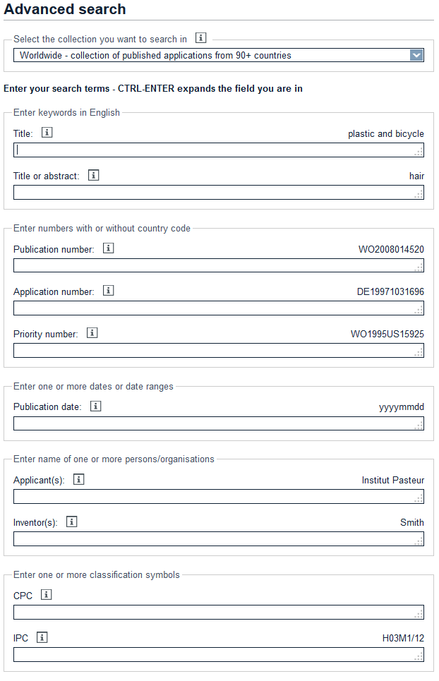
Advanced search
Notes:
In the advanced search mask, each field is labelled with the allowed input. Like fields are grouped together. This makes it easy to construct a complicated search without having to learn "command line" syntax.

Slide 26
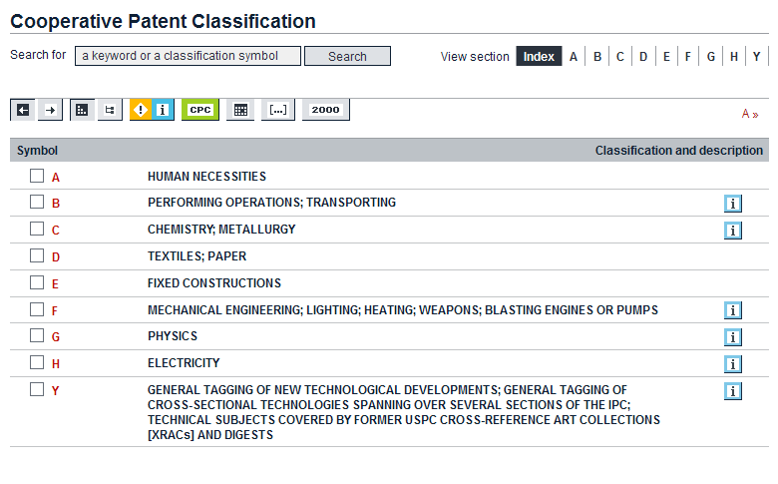
CPC classification search
Keywords or classes
Notes:
The huge numbers of patents in the world are classified to make it easier for patent offices to search and examine. Most of the world's collection is available in Espacenet, so it's obvious that some kind of classification "handle" should be available to help users.
Espacenet has chosen to use the new Cooperative Patent Classification (CPC) scheme. This is a joint project between the EPO and the United States Patent and Trademark Office.

Slide 27
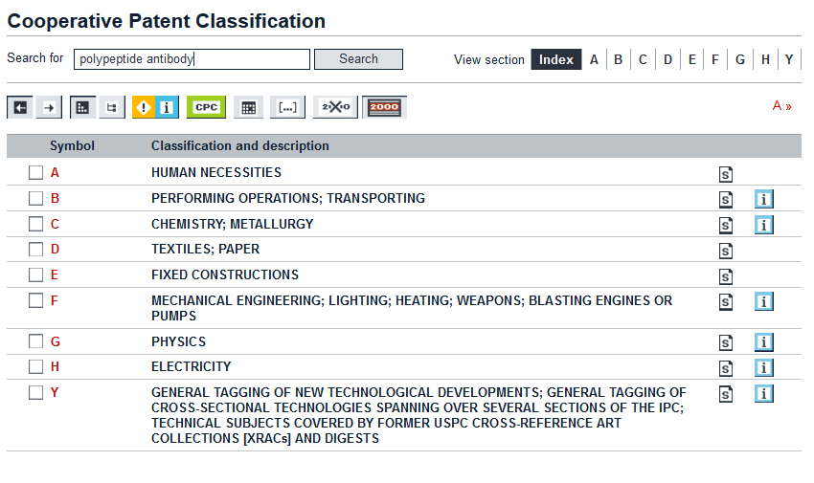
CPC classification search by keywords (I)
Notes:
You can use keywords to search the CPC. In this case we have used “polypeptide antibody“.

Slide 28
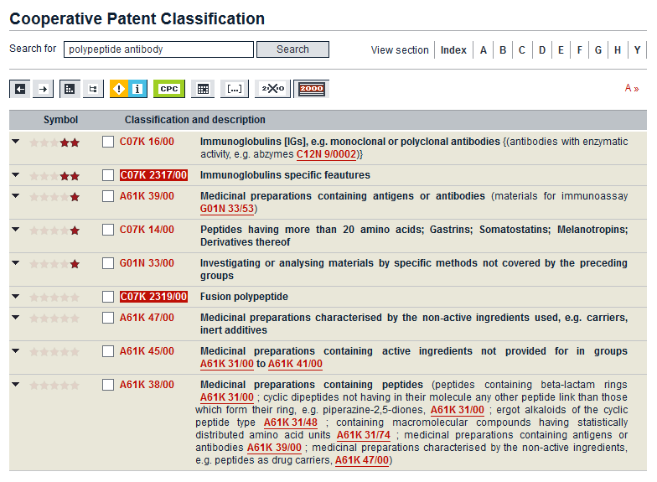
CPC classification search by keywords (II)
Notes:
Our search shows us that the most relevant CPC classification is C07K 16/00.

Slide 29
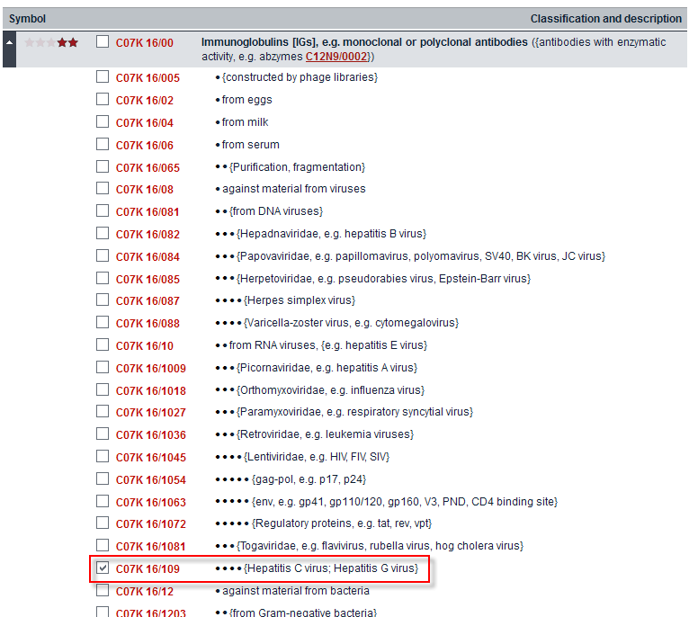
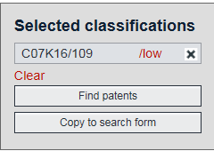
CPC classification search: use classification in search
Notes:
We can drill down into the classification and find the classification for polypeptide antibodies against hepatitis C virus and hepatitis G virus. We can then copy the relevant classification symbol – C07K 16/109 – into the advanced search mask and search further, refining our search with additional terms if need be.

Slide 30
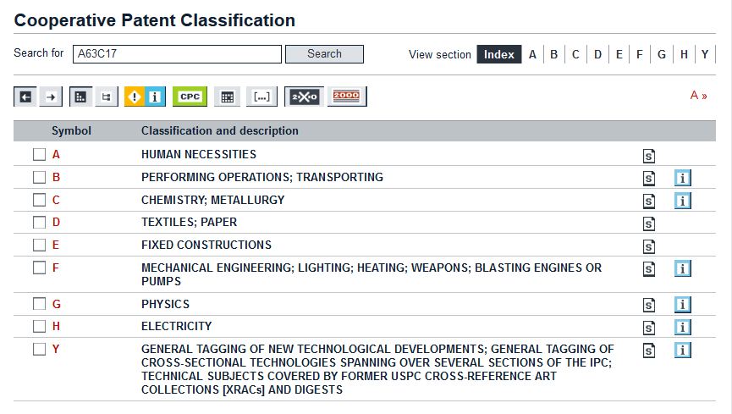
CPC classification search by symbol (I)
Notes:
We can use the classification search in the inverse way, for example if we know a classification term but we don't know what it means.
Let’s say we come across a reference to A63C17, and all we know is that it is something to do with a technology.

Slide 31
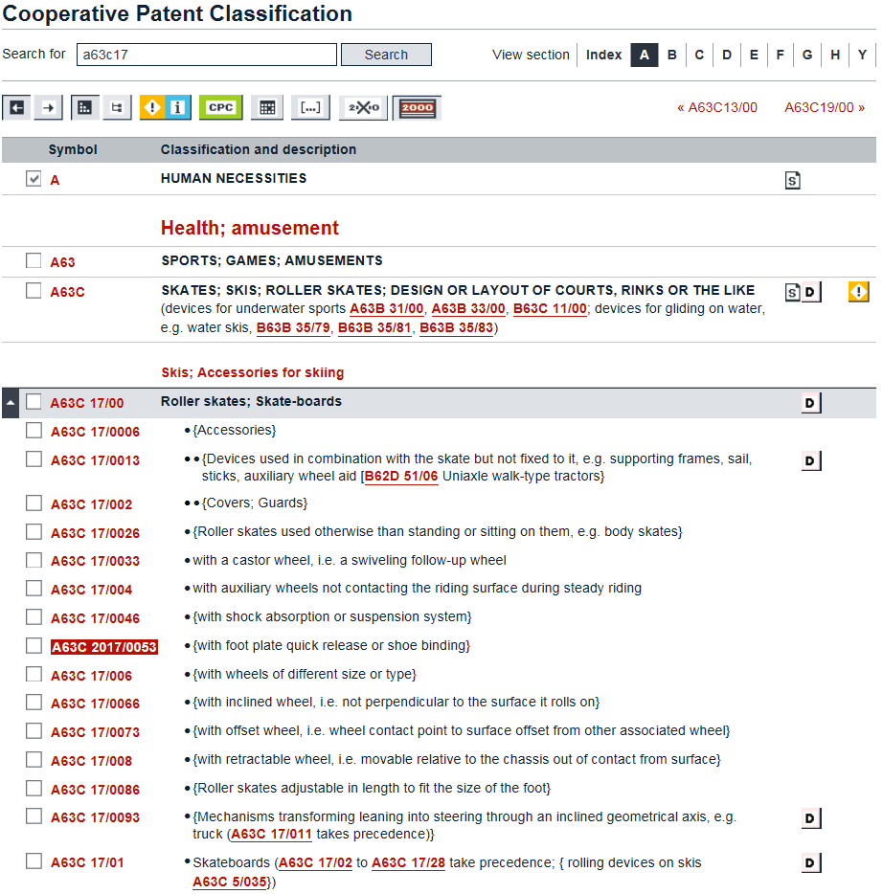
CPC classification search by symbol (II)
Notes:
We input A63C17 into the CPC search box and, sure enough, we find that this classification corresponds to skates, skis, roller skates, etc. And we can drill down into the classification to find the technology subset which really interests us, which is self-propelled skateboards or roller skates – A63C17/12 – “with driving mechanisms”.

Slide 32
CPC classification
Keywords or classes
"Concept search"
Prepare offline (not in Espacenet document databases)
Principle:
Find most appropriate classifications
Copy (into advanced search mask)
Refine search with keywords (do not repeat)
Other search terms
Notes:
The take-home message from the classification search is that you can search with either keywords or symbols to find the "right" classification symbol. This is known as a "concept" search.
We then copy this into the advanced search mask.
We can then refine the search using additional new keywords or other search terms.

Slide 33
Navigation (I)
Breadcrumb navigation
Click Search to refine search
Can always use the browser "back" button (but not to refine search)
Notes:
The purpose of Espacenet is to help you find patent documents. However, a given document may be retrieved in a number of ways: in a hitlist as a result of a search, in a list of family documents, in a list of citing documents, or in a list of cited documents.
In order for you to be able to retrace the steps you took to reach a particular document, Espacenet shows the "breadcrumb trail" – think Hansel and Gretel – so that you can go back to an earlier point in your session or even back to the beginning. It's more sophisticated than the browser Back button.

Slide 34
Navigation (II)
Breadcrumb navigation
Previous – Next (for all sections of document)
Open in European Patent Register
Notes:
If you do generate a list of documents in Espacenet, let's say a hitlist from a search, another useful navigation feature is the "Next/Previous" option. Obviously, this means you can jump forwards or backwards to the neighbouring document in the list. However, that's not all. Let's say you are looking at a description in a particular document. You can use Next/Previous to navigate the list at the description level. And this works at all levels of the document, backwards and forwards throughout the entire list.

Slide 35
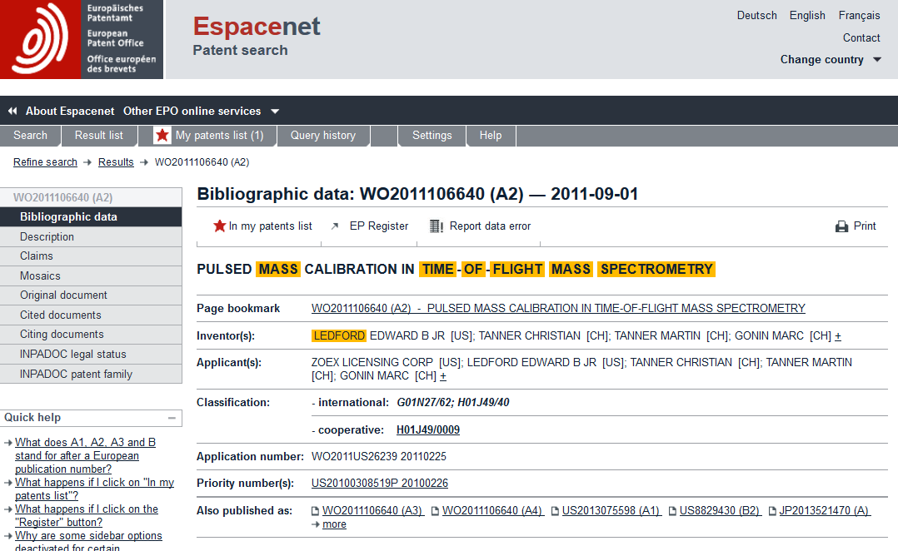
Saving and downloading (I)
Notes:
Espacenet allows you to save and download entire documents, or front pages, to read later.
Just click on the star symbol to add documents to the "My patents list". It will turn from black to red when activated.
Then open the "My patents list" by clicking on "My patents list" in the toolbar.
You'll see a list of documents you have saved. To select a document for download, just tick the check-box at the left-hand end of the title bar.

Slide 36
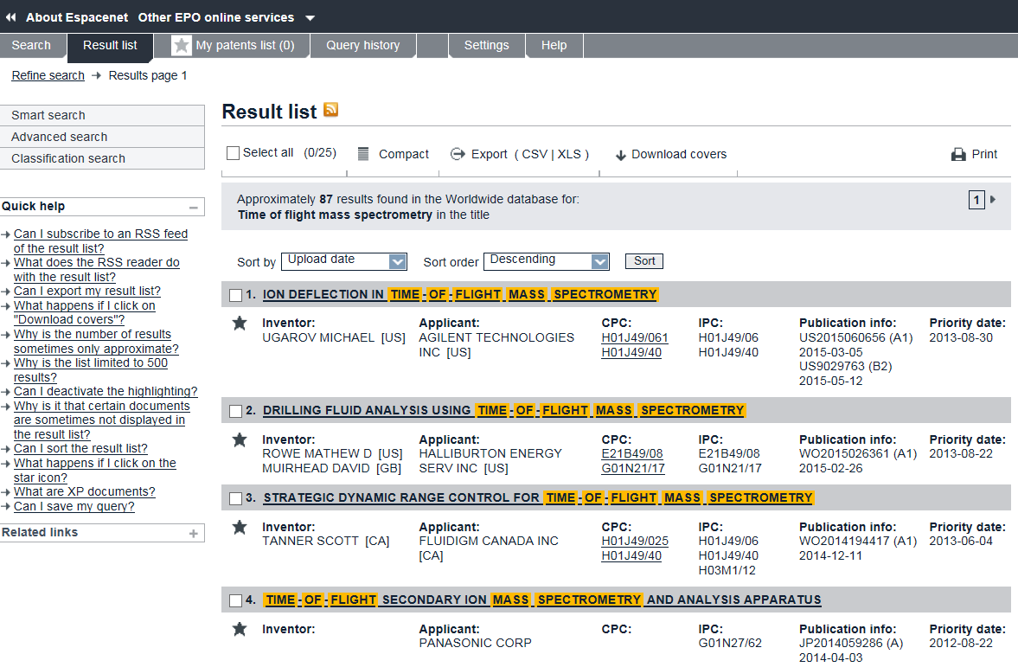
Saving and downloading (II)
Notes:
You can also export the result list.

Slide 37
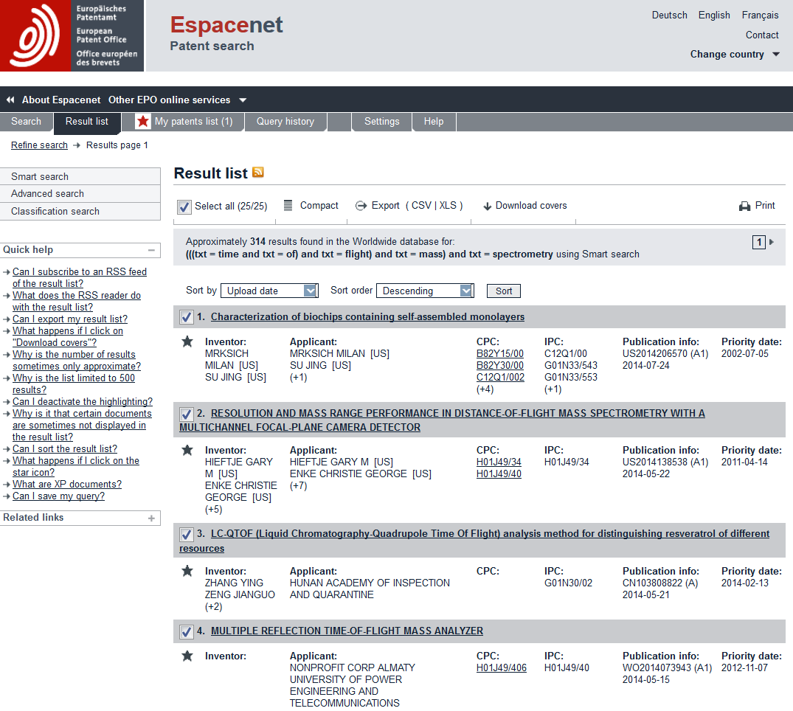
Saving and downloading (III)
My Patents List
Notes:
You can also tick the "select all" box and all documents will be selected for download.

Slide 38
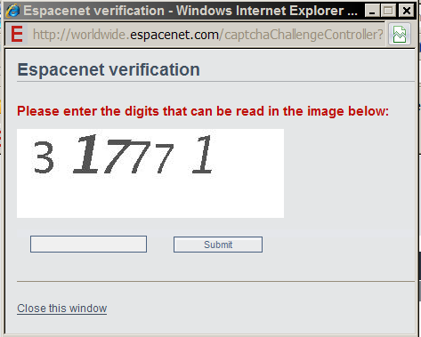
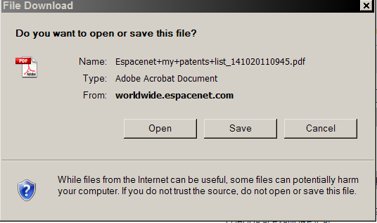
Saving and downloading (IV)
Notes:
Clicking the "Download" option prompts a captcha challenge.

Slide 39
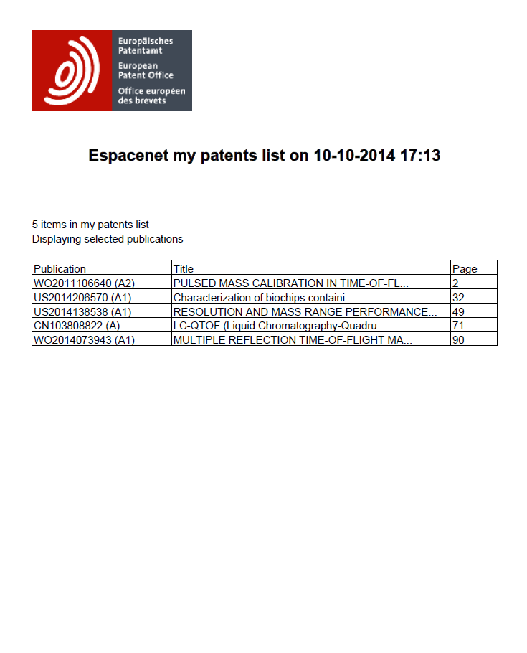
Saving and downloading (V)
Notes:
Successful completion of the captcha challenge opens a PDF file with a table of contents and a table with the titles of the documents you have downloaded.

Slide 40
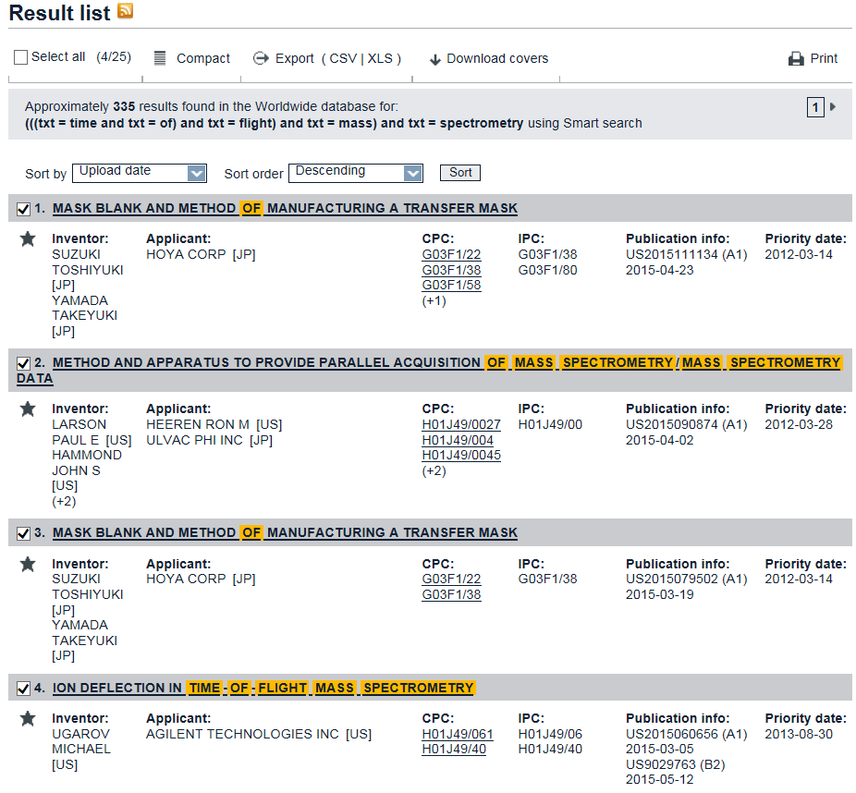
Saving and downloading (VI)
Notes:
From the results list, you can also choose to download just the front pages – or "covers" – from a list of documents.
Check the tick-boxes for the documents you are interested in.
Click on "Download covers".

Slide 41
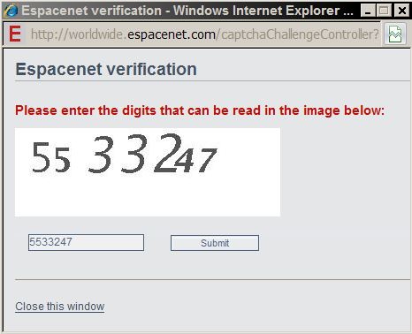
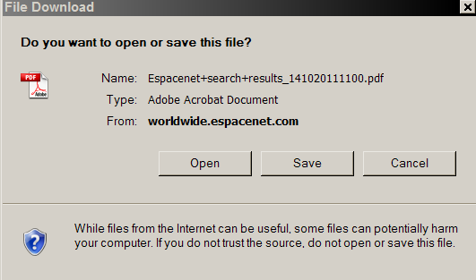
Saving and downloading (VII)
Notes:
This is the captcha challenge for downloading front pages or covers.

Slide 42
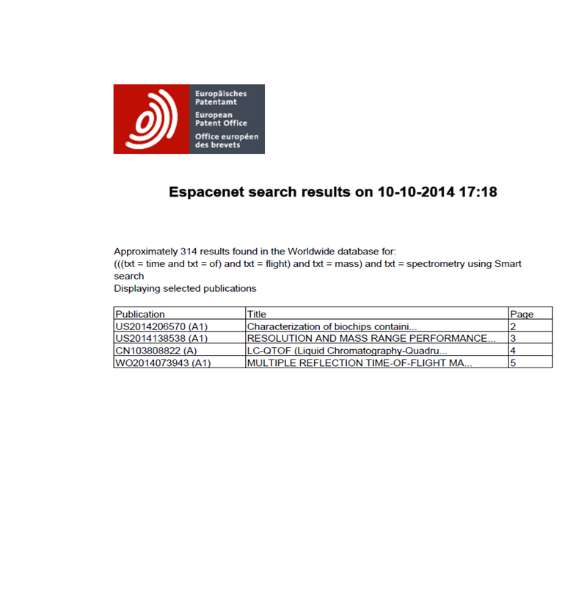
Saving and downloading (VIII)
Notes:
At this stage you'll be shown a small PDF, with a table of contents and a table of titles.
Clicking on the table of contents will open the selected front page.

Slide 43
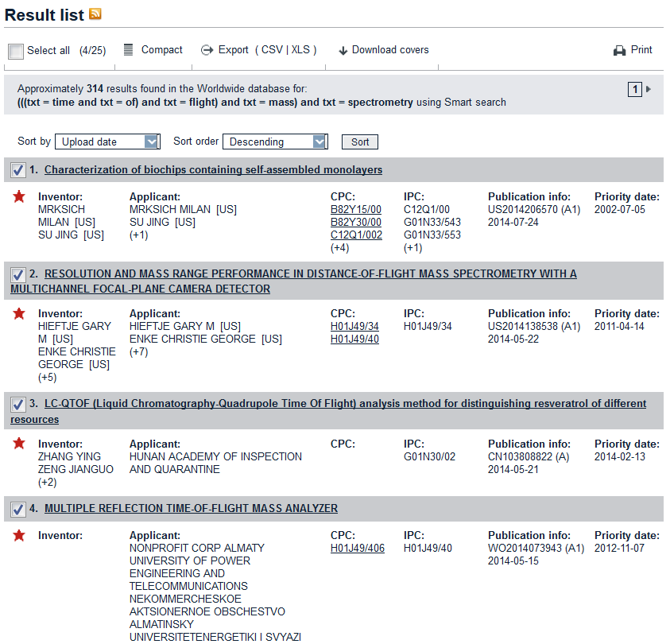
Communication and sharing (I)
Notes:
In order to obtain a hit list in Espacenet, you must first carry out a search. The search will consist of a number of search statements. Now, this search may be important to you, but you don't want to have to remember it or even repeat the search at regular intervals. But what if you nevertheless want to keep up-to-date with that search?
The answer is RSS. If you carry out a successful search and you want to be updated when new documents conforming to that search enter the Espacenet database, then simply set up an RSS feed by clicking the RSS button towards the top left-hand corner of the search result screen.
You will then be informed each time a relevant document enters the database.

Slide 44
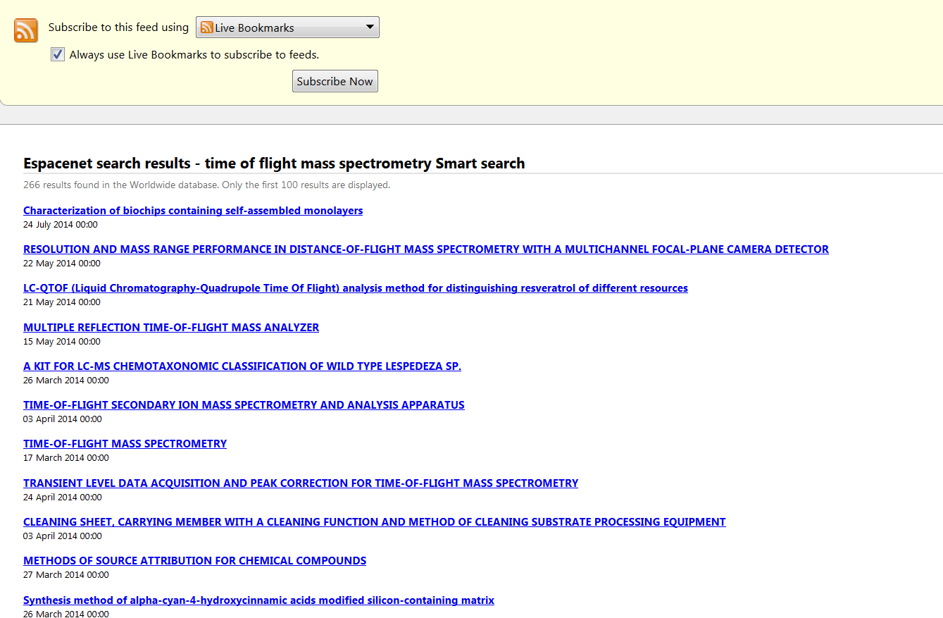
Communication and sharing (II)
RSS Feeds
Notes:
This is an example of an RSS feed set up from an Espacenet search result list.

Slide 45
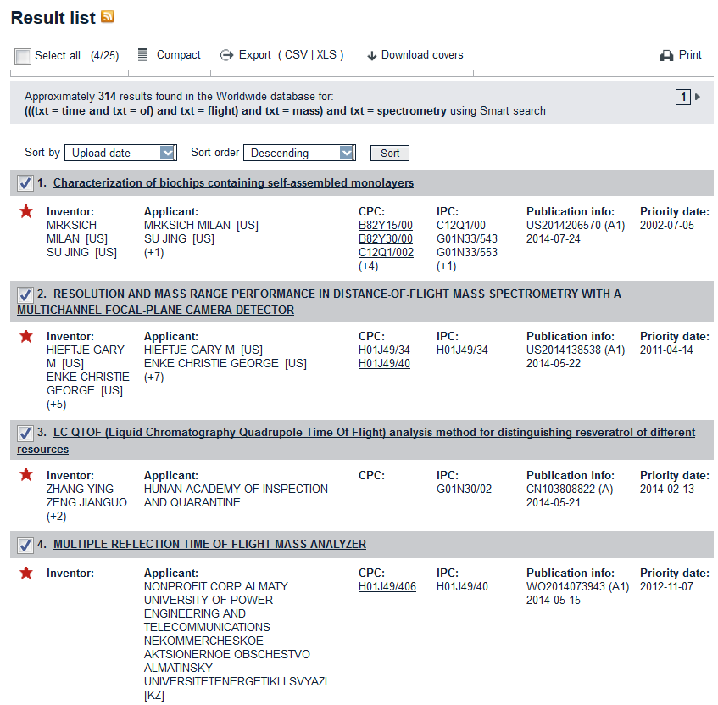
Communication and sharing (III)
Notes:
You may also want to share your search results with others. The simplest way to do this is to click the Export XLS option from the toolbar.
This creates an Excel table from the html result list. The table includes the main bibliographic elements shown in the result list. But the most important thing is that the publication numbers are exported as live URL links, so that if you send this list to someone else (as an attachment maybe) the recipient can access the same documents as you did when you first performed your search.
As it is an Excel table, you can manipulate and sort it using standard Excel functions.

Slide 46
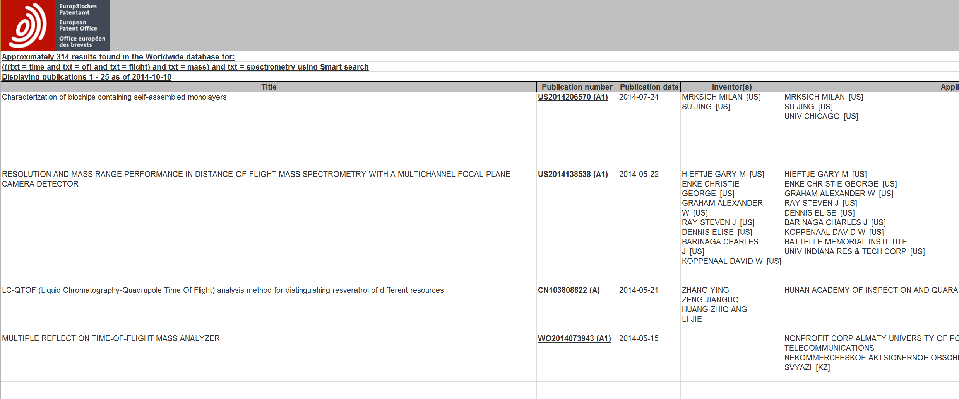
Communication and sharing (IV)
Export to Excel – Can use Excel functions
Links Preserved
Notes:
This is what an export from Espacenet to an Excel table looks like.

Slide 47
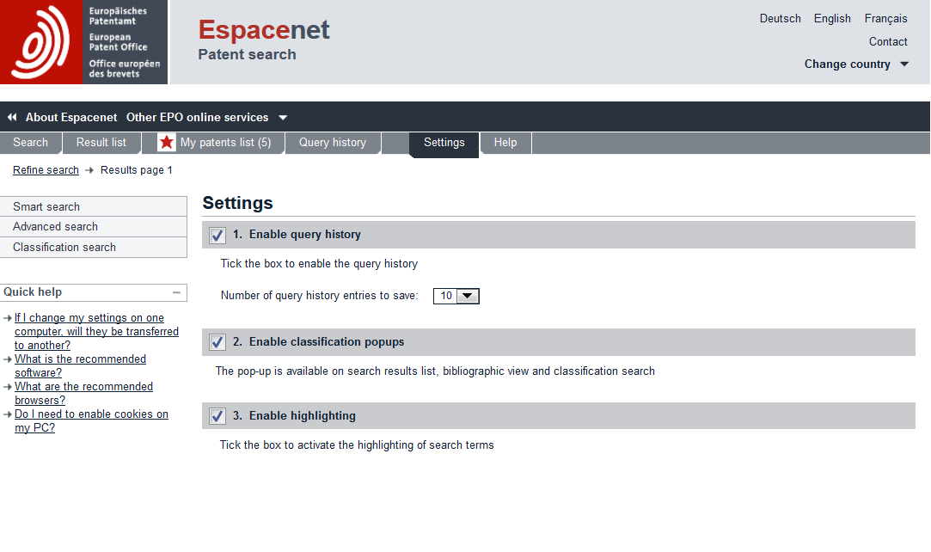
Settings (I)
Enable Query History
Notes:
The settings menu allows you to customise your Espacenet interface.
We recommend that you tick the “Enable query history” option, so that up to 50 of your query histories will be stored.
If you tick “Enable classification pop-ups”, you will get mouse-over tool tips which show additional classification information when the cursor is over a classification symbol in, say, a bibliographic view.
If you want search terms to be highlighted, tick the “Enable highlighting” box.

Slide 48
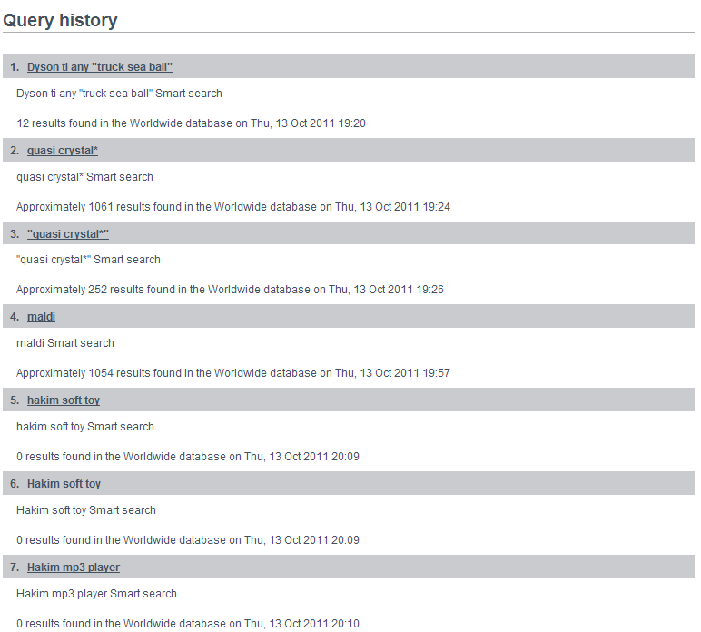
Settings (II)
Notes:
If you have chosen to save your query histories, they will be displayed in a list like this.

Slide 49
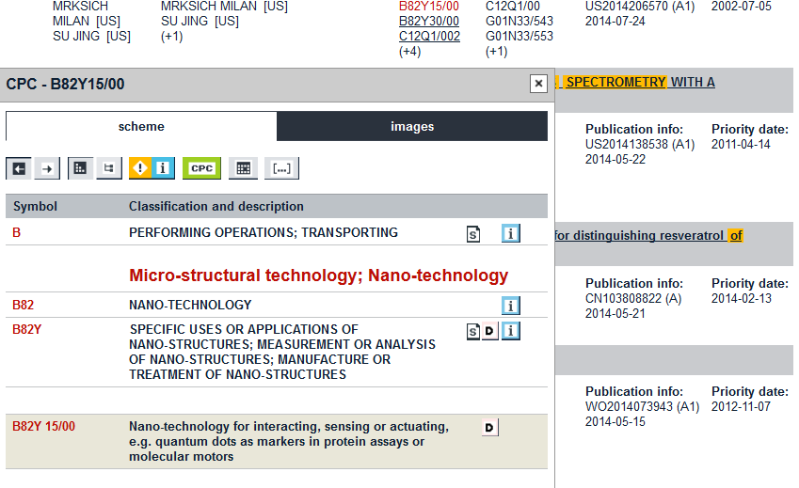
Enable pop-ups
Enable highlighting
Enable
pop-ups
Notes:
If you have enabled classification pop-ups in your settings menu, when you hover over or click on a classification symbol on screen, the corresponding pop-up with additional classification information appears.

